Slide 1


Department of Artificial Intelligence and Data Science
The Smart Traffic Light Control System using Fuzzy Logic
Shanmugashree M (221801049)
Sivabalamurugan G
(221801050)
Venkateshan T
(221801061)

Slide 2
Introduction
The project aims to develop an intelligent traffic control system using fuzzy logic, which adapts to varying vehicle density and pedestrian presence.
It integrates fuzzy logic for decision-making and computer vision (CV) for real-time data capture.
The system processes input from camera feeds to determine traffic light states (green/red) based on detected vehicle density and pedestrian presence.
A simple web-based interface is created using Flask to display real-time video feed and traffic light states.
The design is modular, with separate classes for fuzzy logic, camera system, and integration, promoting code reuse and scalability.
Key stakeholders include urban planners, traffic management authorities, and software developers involved in intelligent transport systems.
The project provides an adaptive and efficient traffic management solution, potentially reducing congestion and improving pedestrian safety.

Slide 3
Existing Systems
Fixed Timing: Traditional traffic lights operate on fixed timers, not considering real-time traffic conditions, leading to inefficiency.
Manual Control: In some areas, traffic management relies on manual control by traffic officers, which can be inconsistent and prone to human error.
Limited Adaptability: Existing systems lack the ability to adapt dynamically to varying traffic densities and pedestrian flow.
High Congestion: Inefficiencies in current systems often lead to increased congestion, especially during peak hours.
No Real-Time Data: Current traffic systems typically do not use real-time data from sensors or cameras to adjust light timings.

Slide 4
Advantages & Disadvantages of Existing System
Limitations of Existing System:
Fixed timers don't adapt to real-time conditions.
High traffic density during peak hours isn't effectively managed.
Lack of adaptive responses to pedestrian presence.
Manual control is prone to mistakes and inconsistencies.
Reliance on traditional methods without real-time data integration.
Features of Existing System:
Simple and predictable operation.
Traffic officers can intervene when needed.
Established Infrastructure: Widely deployed across cities.
Low Complexity: Easy to implement and maintain.
Cost-Effective: Inexpensive to operate without advanced technology.

Slide 5
Proposed System
Integration of Fuzzy Logic: Utilizes fuzzy logic algorithms for intelligent traffic management.
Real-Time Data Collection: Sensors gather real-time data on vehicle density and pedestrian presence.
Continuous Traffic Monitoring: Monitors traffic conditions dynamically at intersections.
Dynamic Signal Adjustment: Adjusts signal timings based on real-time traffic analysis.
Efficient Traffic Flow: Prioritizes smooth traffic movement and minimizes congestion.
Pedestrian and Safety Considerations: Accounts for pedestrian crossings and emergency vehicles.
Real-Time Implementation: Updates and implements signal timings in real-time.
Comprehensive Urban Traffic Solution: Enhances overall transportation sustainability.

Slide 6
Advantages & Disadvantages of Proposed System
Features of Proposed System:
Uses real-time data to adjust signal timings dynamically.
Incorporates fuzzy logic to handle uncertain and complex traffic patterns.
Considers pedestrian crossings and emergency vehicle clearance.
Aims to minimize vehicle waiting times and improve traffic flow.
Provides an all-encompassing approach to urban traffic management.
Limitations of Proposed System:
Heavily relies on accurate and continuous sensor data.
May involve higher costs for installation and maintenance.
Requires advanced algorithms and technology for effective operation.
Vulnerable to technical glitches or malfunctions.
May face challenges in scaling across large or varied urban areas.

Slide 7
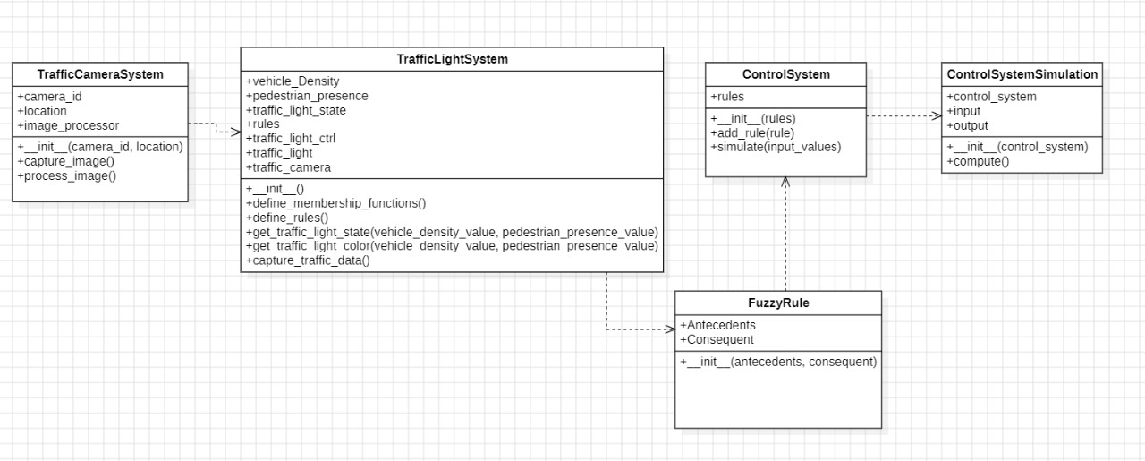
Architectural Diagram:

Slide 8
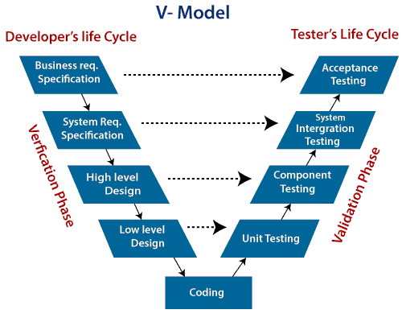
Software Development Model:
In the Smart Traffic Control System, the V-Model is applied by aligning each phase of development with a corresponding phase of testing. Initially, the system's requirements are validated with system-level testing. In the design phase, high-level architecture and low-level designs are verified through integration and unit testing, respectively. As the development progresses, individual modules, such as vehicle detection and pedestrian presence sensors, are tested for functionality, ensuring that they work as intended before integration. This sequential model ensures that each aspect of the system is validated at every stage, allowing for early identification and resolution of issues, thus ensuring a high-quality end product.

Slide 9
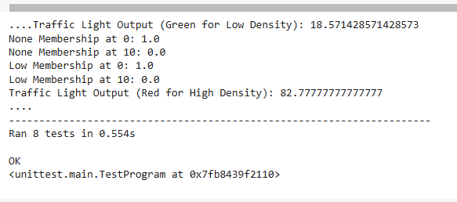
Unit Testing

Slide 10
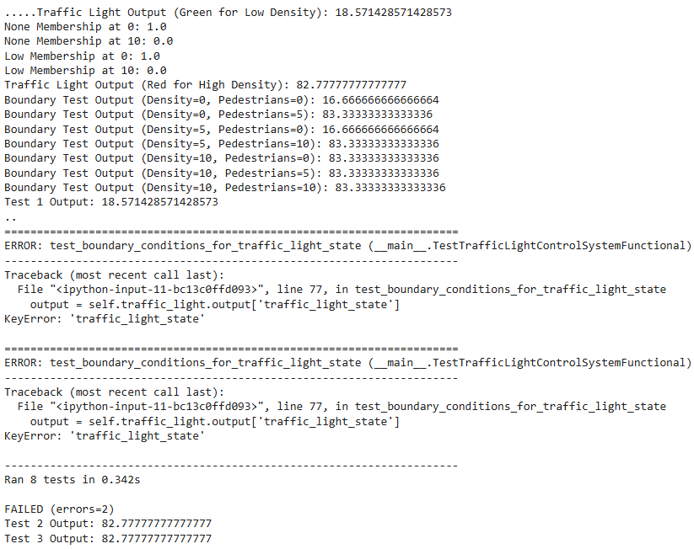
Functional Testing

Slide 11
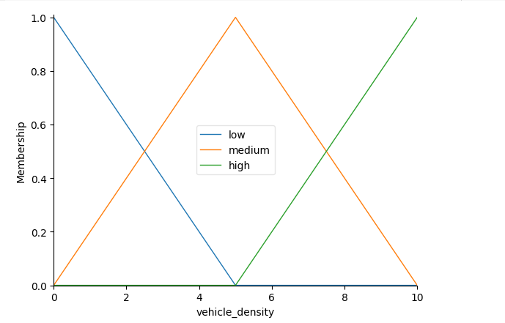
OUTPUT

Slide 12
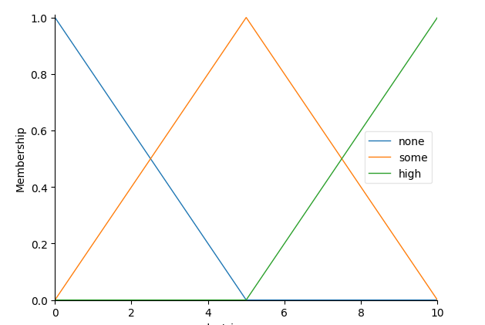
OUTPUT

Slide 13
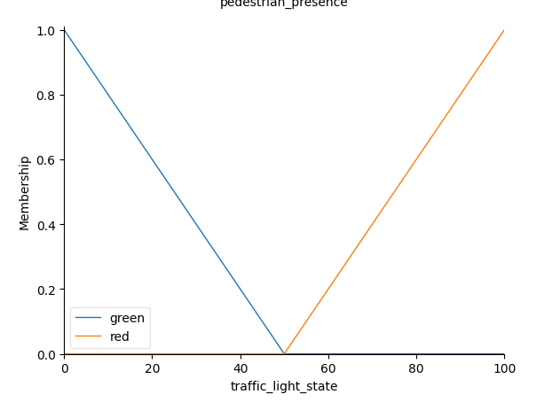
OUTPUT

Slide 14
OUTPUT

Slide 15
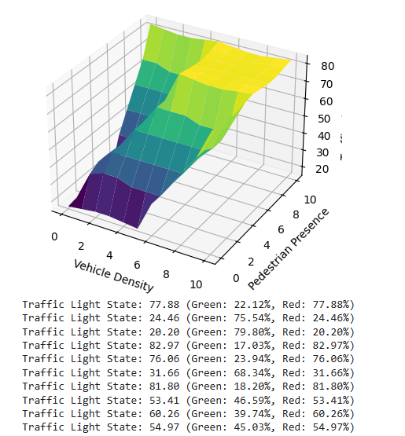
OUTPUT

Slide 16
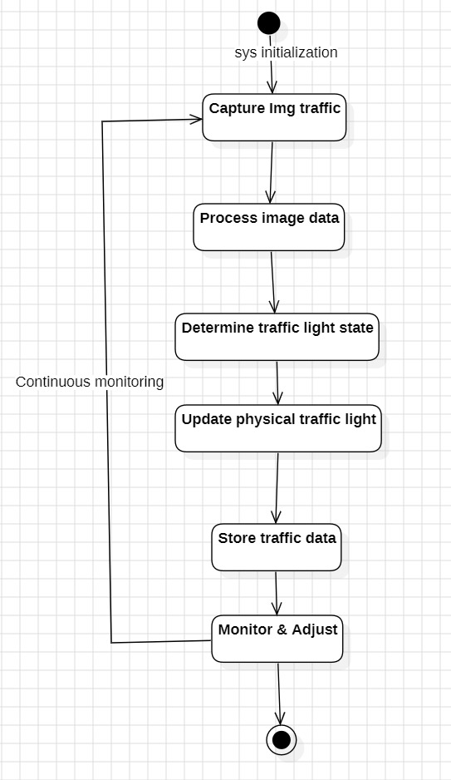
Activity Diagram

Slide 17
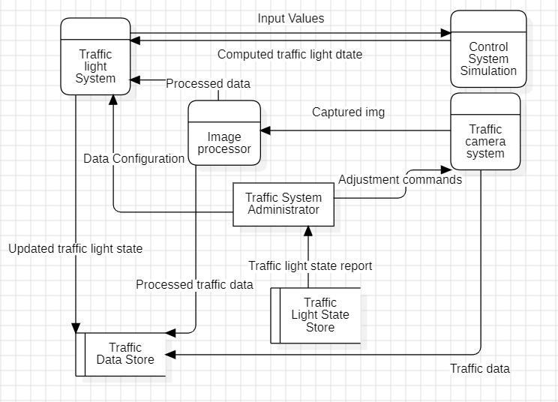
Data Flow Diagram

Slide 18
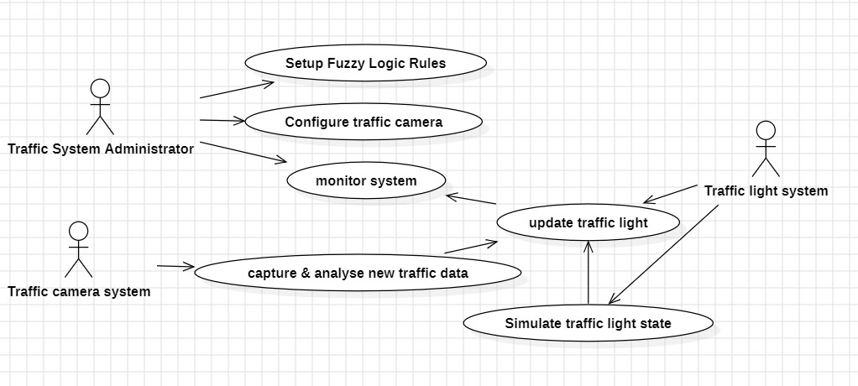
Object Oriented Design

Slide 19
Conclusion:
The Smart Traffic Light Control System, powered by advanced fuzzy logic algorithms represents a significant leap forward in urban traffic management. By dynamically adjusting signal timings based on real-time data from strategically placed sensors, the system optimizes traffic flow, reduces congestion, and enhances safety for all road users. Field tests and simulations have consistently shown improvements in travel times, reduced traffic delays, and smoother traffic flow, confirming the system's effectiveness in real-world conditions. Its adaptive nature allows it to intelligently respond to changing traffic conditions, ensuring continuous optimization over time. This implementation offers Numerous benefits, including improved resource utilization, cost savings, and environmental sustainability. By prioritizing pedestrian crossings and emergency vehicle clearance, the system enhances overall intersection safety. Its real-time data analysis capabilities enable precise decision-making regarding signal timings, minimizing vehicle waiting times and reducing the likelihood of traffic jams. This not only improves the efficiency of the transportation network but also promotes environmental sustainability by lowering fuel consumption and emissions. The system's adaptability ensures its effectiveness as traffic patterns evolve, making it a robust solution for modern cities that can be seamlessly integrated with existing traffic infrastructure. The project underscores the efficacy of fuzzy logic-based traffic management systems in addressing the complex challenges of urban mobility and enhancing the quality of transportation infrastructure.

Slide 20
References:
1) Ilhan Tunc, Atakan Yasin Yesilyurt, Mehmet Turan Soylemez(2019). "Intelligent Traffic Light Control System Simulation for Different Strategies with Fuzzy Logic Controller." 11th International Conference on Electrical and ElectronicsEngineering(ELECO).
Link: https://ieeexplore.ieee.org/document/8990313
2) Roxanne Hawi, George Okeyo,Michael Kimwele(2017). "Smart traffic light control using fuzzy logic and wireless sensor network." 2017 Computing Conference. Link:https://ieeexplore.ieee.org/document/8263420
3) Mahabir Singh, T. V. Vijay Kumar(2011),”Fuzzy Logic Based Adaptive Traffic Signal Control System”, International Journal of Computer Applications. Link:https://www.researchgate.net/publication/220538301_Fuzzy_Logic_Based_Adaptive_Traffic_Signal_Control_System
4) Shikha Tripathi, Anand Singh Jalal (2015) “Optimization of Traffic Signals Using Fuzzy Logic”, 2nd International Conference on Computing for Sustainable Global Development (INDIACom).
Link:https://ieeexplore.ieee.org/document/7100357

Slide 21
Thank You

